Slide 1


Big Mountain Resort
Best value for ticket price

Slide 2
Current state
Price for an adult ticket is $81
Vertical Drop 2353
Runs 105
Night skiing acreage 600

Slide 3
Transition
Increase ticket price that can be supported by the market share
Decrease operating costs

Slide 4
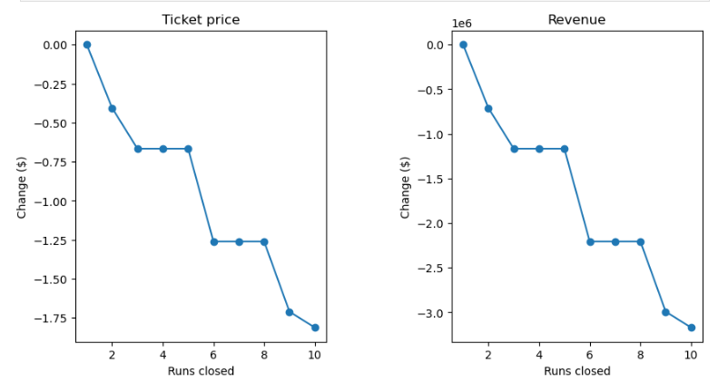
Changes
Increase ticket price to $83
Add a new run
Add a new chair lift
Add additional vertical drop
Decrease operating cost by closing 5 of the least used runs. (we can see the impact for revenue in the graphs)

Slide 5
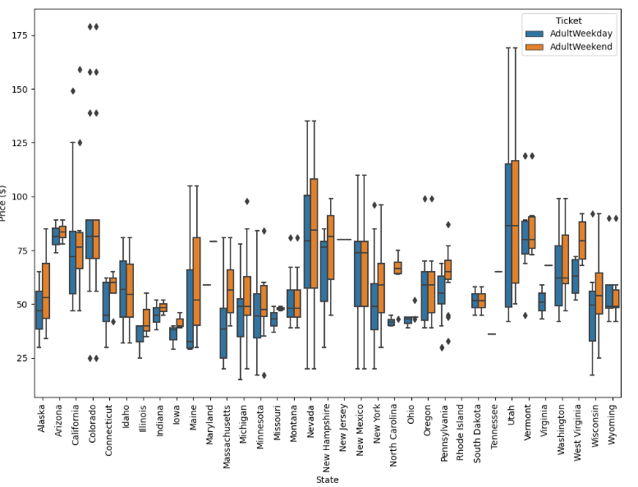
Analysis
We looked at the country with the current ticket pricing.
This was compared to what features each location valued
We took state information to better scale the information to really show where value was.

Slide 6
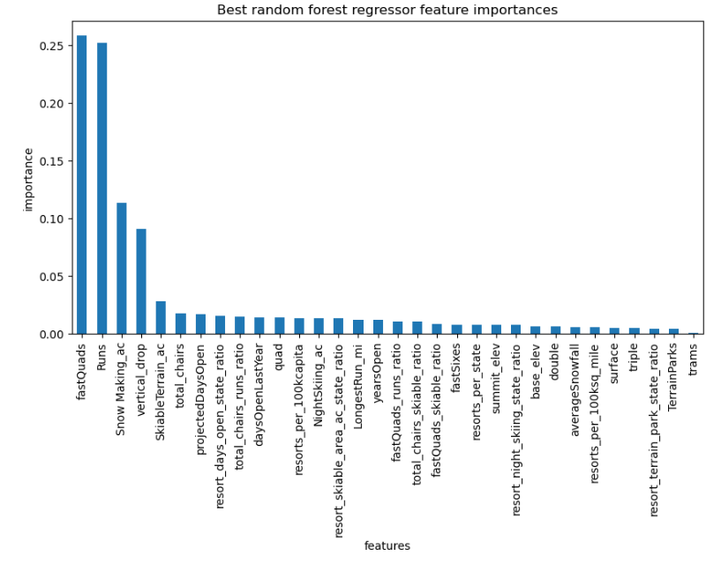
Features
Features that people will pay more for include
Number of runs
Snow making acreage
Vertical drop
Skiable terrain acreage

Slide 7


Summary
Increase the ticket price as we have established value in offered features. Increase to $83per adult ticket. Open a new run with chair lift. Increase the vertical drop. Decrease operating costs by closing the five least used runs.

